Slide 1
Node 5: Ai TinyOD-Brake
Presenter: Sobhan Nasiri
TinyML-based obstacle detection and emergency braking system simulated on STM32F401VE using STM32Cube.AI, CMSIS-NN, and Proteus. ONNX model deployed on Arm Cortex-M4.

Slide 2
Node 5 — Mission & Responsibilities
What this node must do inside the smart car
Environmental Perception
Captures a simulated 96×96 grayscale image, applies fixed‑point preprocessing (no FPU), and runs an INT8 CNN inference to detect obstacles in real time.
Risk Assessment & TTC Calculation
Uses simulated distance and speed to compute Time‑to‑Collision (TTC) with integer arithmetic; the TTC value determines the urgency of the response.
Finite‑State Machine(FSM) Decision Logic
Implements four safety states (Normal, Warning, Brake, Safe Stop) and transitions based on obstacle probability and TTC thresholds to ensure controlled braking.
Graphical LCD Display
Shows live system status, obstacle probability, TTC, and current state on a 240×320 ILI9341 LCD via SPI, updated at ~4 FPS for clear operator feedback.

Slide 3
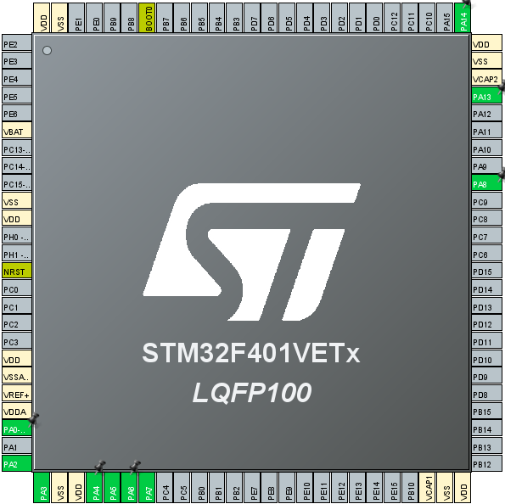
STM32CubeMX Configuration
Peripheral Setup, Pin Mapping, and System Initialization
OLED RST
Button(B1_Pin)
USART2_TX
USART2_RX
OLED_CS
SPI1_MOSI
SPI1_SCK
OLED_DC

Slide 4
Three Development Phases
Each phase added one layer to the same firmware
Phase1
Infrastructure, Data & Model Development
Environment Setup: STM32CubeMX, Keil MDK, Proteus simulator
Hardware Configuration: STM32F401VE (84 MHz, 96 KB RAM, 512 KB Flash)
Synthetic Dataset Generation: 96×96 grayscale images (noise + random obstacle squares)
Data Preprocessing: Fixed‑point normalization (no FPU)
CNN Design: Lightweight depthwise‑separable architecture (~16k params)
Training & Optimization: PyTorch → ONNX → (STM32Cube.AI)
phase2
TinyML Deployment & Decision Logic
AI Inference: CMSIS‑NN accelerated inference on STM32 (bare‑metal C)
Sensor Simulation: Dynamic frame generator (obstacle size/probability)
Risk Assessment: Time‑to‑Collision (TTC) calculation from simulated distance/speed
Finite State Machine (FSM): States – NORMAL, WARNING, BRAKE, SAFE_STOP
Graphical LCD (ILI9341): Displays state, obstacle probability, TTC, and live frame
UART Logging: Transmits inference latency, RAM usage, and state changes for debugging
phase3
Integration, Emergency Scenarios
System Integration: FSM output to actuator signals (GPIO toggles)
Team Coordination: Send state and speed data to other modules (team members 4 & 3)
Emergency Scenarios: TTC‑based braking logic with <50ms reaction time
IoT (Optional): Transmit emergency braking status via UART / wireless link
Full Proteus Simulation: Virtual terminal, LCD, and cycle‑accurate timing validation
Performance Metrics: ~74 KB RAM, ~25.8 FPS, 38.7ms inference latency
Node 5
Ai TinyOD-Brake

Slide 5
Infrastructure, Data & Model Development
Phase 1
This phase includes the complete steps of building, training and using a very lightweight machine model for use in a Microcontroller Unit (MCU). The codes are written in a modular manner.

Slide 6
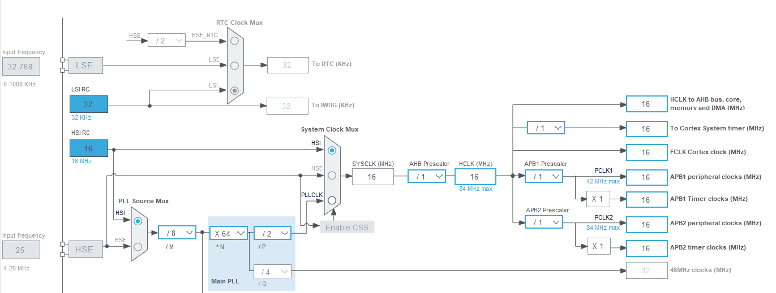
Development Toolchain & Hardware Platform
Setting up the environment before writing a single line of AI code
Target MCU: STM32F401VET6, LQFP100 package, Arm Cortex‑M4 core — selected for its balance of processing power and TinyML‑class memory (96 KB RAM / 512 KB Flash).System
Clock: Configured via STM32CubeMX at 16 MHz (HSI‑derived SYSCLK), propagated to AHB/APB1/APB2 buses at 16
MHz.Toolchain: STM32CubeMX for pin/clock configuration, Keil MDK‑ARM (uVision 5) for firmware development, Proteus 8 Professional for full hardware‑software co‑simulation (no physical board used).

Slide 7
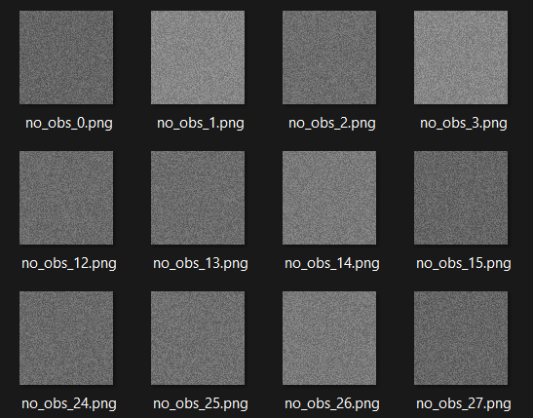
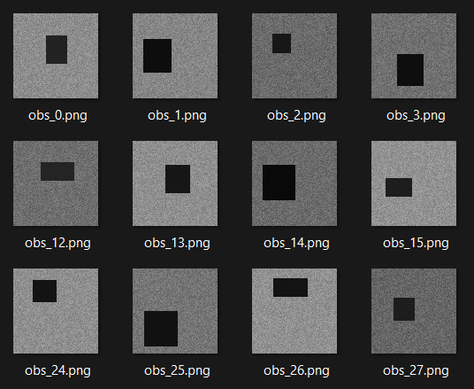
Synthetic Dataset Generation
No real-world dataset available — so one was generated programmatically
Why synthetic: No camera or real obstacle dataset was available for this MCU‑only pipeline, so
generate_data.py procedurally builds the training set.
Class 0 — no_obstacle: Background noise only.
Class 1 — obstacle: Same background noise plus a randomly placed dark square simulating an obstacle.
Volume: 200 synthetic 96×96 grayscale images per class (400 total).

Slide 8
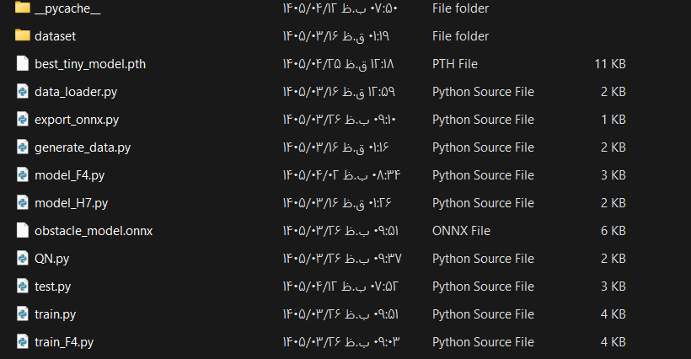
Data Preprocessing & Loading Pipeline
Preparing images for a memory-constrained MCU
Custom Dataset Class: TinyObstacleDataset in data_loader.py reads all generated images via PIL.
Resize: All images normalized to a fixed 96×96 resolution to match the model's expected input.
Grayscale Conversion: Images converted to single-channel grayscale — cuts RAM footprint 3× versus RGB and speeds up inference.

Slide 9
CNN Architecture — TinyObstacleNetMCU
A custom, MCU-optimized convolutional network
Design Goal: A binary classifier small enough to fit STM32F401VE's memory and compute budget.
Key Technique — Depthwise Separable Convolution (DSC): Splits a standard convolution into a depthwise pass + a 1×1 pointwise pass, drastically cutting parameter count and MACC operations versus a standard Conv2d.
Output Head: Global Average Pooling → Fully Connected (16→1) → Sigmoid, producing an obstacle probability between 0 and 1.

Slide 10
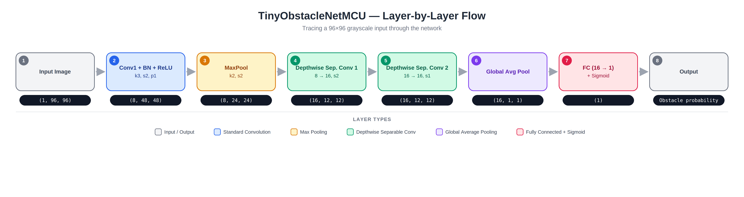
Design note: The number of filters in the first layer (8) is a manually chosen hyperparameter, not something derived from a formula — only the spatial output size of each layer follows the convolution/pooling formulas.

Slide 11
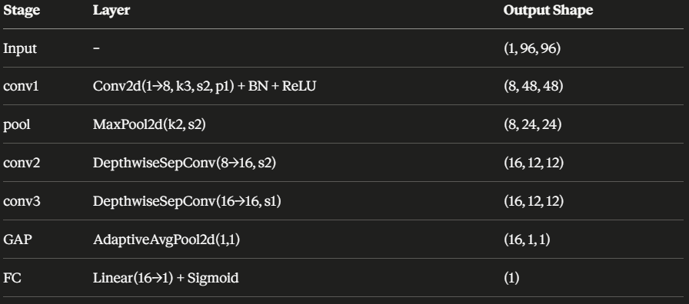
Layer-by-Layer Output Dimensions
Tracing a 96×96 input through the network
Use the table itself as the slide's main visual — no external image is needed here.

Slide 12
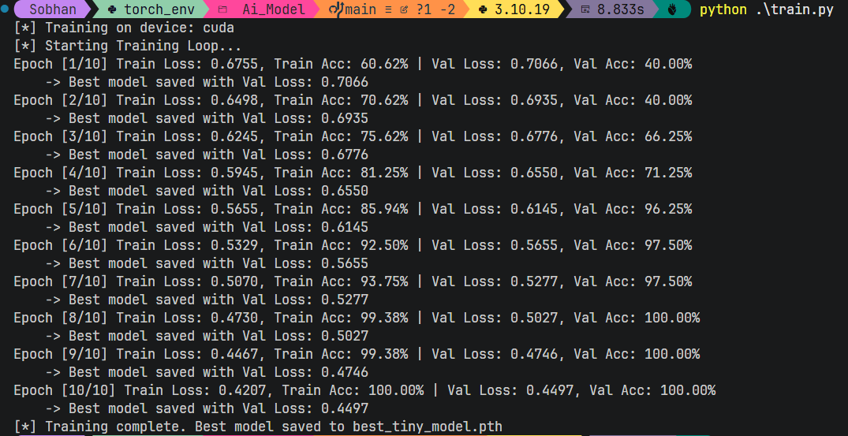
Model Training & Export
From PyTorch weights to a hardware-portable format
Split: 80/20 random train/validation split.
Loss & Optimizer: Binary Cross-Entropy (BCE) loss with the Adam optimizer.
Schedule: 10 training epochs; the model checkpoint is saved whenever validation loss improves.
Result: Training accuracy reached 100% and validation accuracy reached 100% by epoch 8–10, with validation loss converging to 0.4497.
Export: The best checkpoint (best_tiny_model.pth) is exported to the ONNX (Open Neural Network Exchange) format via export_onnx.py, decoupling the model from PyTorch so it can be translated to C by hardware vendor tools.

Slide 13
TinyML Deployment & Decision Logic
Software development
Phase 2
In the second phase, the written code is structured and various modules, including the sensor simulator, the AI ​​Inference Engine, the Risk Calculator, and the Finite State Machine (FSM), are integrated together (Integration). This phase forms the core logic of the program. And we will transfer the training model from the previous phase to a real hardware (microcontroller). This phase includes configuring the hardware, deploying the model using the manufacturer's development tools, setting up the display to show visual output, and setting up the serial port for debugging.

Slide 14
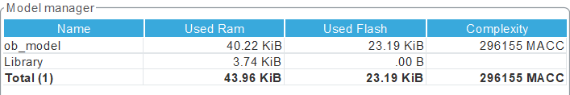
Model Deployment via STM32Cube.AI
Translating ONNX into optimized embedded C
Import: The ONNX model is imported into X‑CUBE‑AI, which converts the Conv2D / Pooling / Dense graph into C code backed by CMSIS‑NN kernels.
Memory Footprint: 40.22 KiB RAM (activations) + 3.74 KiB (library) ≈ 43.96 KiB total RAM; 23.19 KiB Flash for weights.
Compute Cost: ≈296,155 MACC (Multiply‑Accumulate) operations per inference — confirmed by Cube.AI as feasible for this MCU.

Slide 15
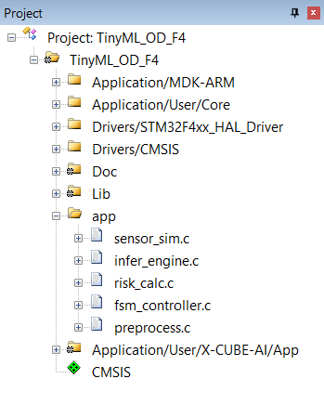
Software Architecture & Modularization
Keeping main.c clean through modular design
Principle: Rather than crowding logic into main.c, functionality is split into a dedicated app/ folder.
Modules: sensor_sim.c (frame generation), infer_engine.c (AI wrapper), risk_calc.c (TTC), fsm_controller.c (state machine), preprocess.c (normalization).
Benefit: Significantly improves code readability and long-term maintainability; grouped in Keil via Add Group.

Slide 16
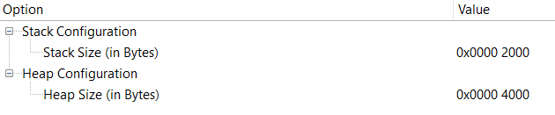
Memory Configuration (Stack & Heap)
Keeping main.c clean through modular design
Why it matters: ML activation buffers and temporary variables need generous RAM; functions like snprintf also require adequate stack space.
Stack Size: 0x2000 (8 KB)
Heap Size: 0x4000 (16 KB)
Result: Sized specifically to avoid stack/heap overflow errors during inference and UART logging.

Slide 17
Peripheral Interfaces: SPI Display & UART Debug
Getting visual and textual feedback out of the MCU
LCD (ILI9341) over SPI1: 8‑bit, MSB‑first, Prescaler 2, CPOL Low / CPHA 1st Edge. PA5→SCK, PA7→MOSI, PA4→CS, PA6→DC, PA8→RST.
UART Debug (USART2): 9600 baud, 8 data bits, no parity, 1 stop bit. PA2→TX, PA3→RX, connected to Proteus's Virtual Terminal.
Interrupt-driven RX: USART2 interrupt registered in NVIC so incoming data doesn't block the main loop.

Slide 18
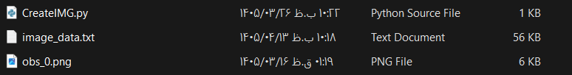
AI Inference Engine & Preprocessing Pipeline
From raw pixels to a probability score
Test Input Strategy: Since a direct camera‑to‑MCU link isn't feasible in Proteus, 5 sample 96×96 images are converted to hexadecimal C arrays (via a Python script) and stored in Flash as test vectors.
Normalization: Preprocess_NormalizeFloat converts raw pixel bytes to float values before inference.
Inference Call: infer_engine.c invokes the Cube.AI‑generated ai_ob_model_run() function.
Output: A float between 0–1, multiplied by 100 to report an obstacle probability percentage.

Slide 19
Risk Assessment (TTC) & FSM Decision Logic
Turning a probability into a driving decision
TTC Formula: TTC = (Distance × 1000) / Speed, computed in risk_calc.c from simulated distance/speed values.
Four States: NORMAL → WARNING → BRAKE → SAFE_STOP, implemented in fsm_controller.c.
Trigger Condition: If the system is in WARNING and TTC drops below 1200 ms, it immediately transitions to BRAKE.
Display Sync: The LCD updates its status text/color in main.c in lockstep with the current FSM state.

Slide 20
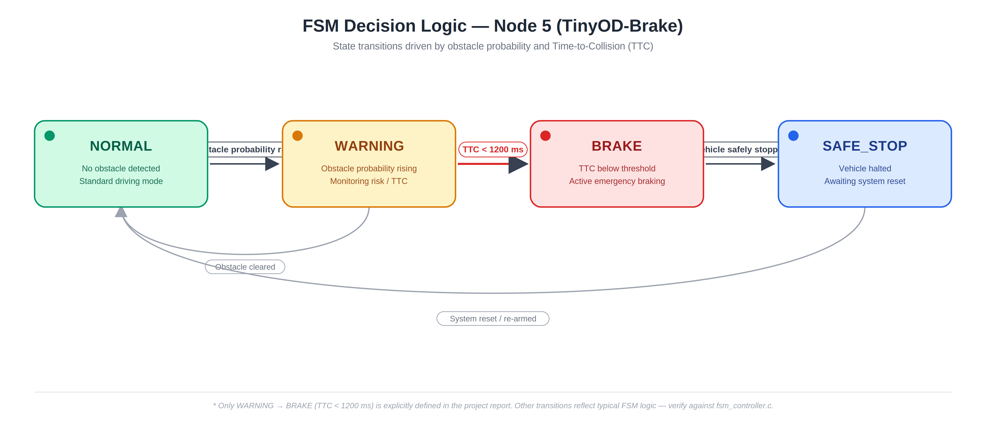

Slide 21
Integration, Emergency Scenarios & Proteus Simulation
Phase 3
In this phase, all modules developed in previous phases (artificial intelligence, control logic and display drivers) were integrated and tested on the virtual hardware of the VE401F32STM microcontroller in the Proteus environment. The aim of this phase is to evaluate the correctness of the performance of the entire system in a simulated environment before implementing it on a real board.

Slide 22
Schematic Design & Hardware Wiring
Assembling the virtual prototype in Proteus
MCU: STM32F401VE placed as the central processing unit.
Debug Link: UART TX/RX (PA2/PA3) wired to Proteus's Virtual Terminal for real-time monitoring.
Display: ILI9341 color LCD wired via SPI, with mode-select pins (IM0–IM3) and control lines (CS, RES) tied to MCU GPIOs.
Input: A push-button used to step through the 5 test scenarios.

Slide 23
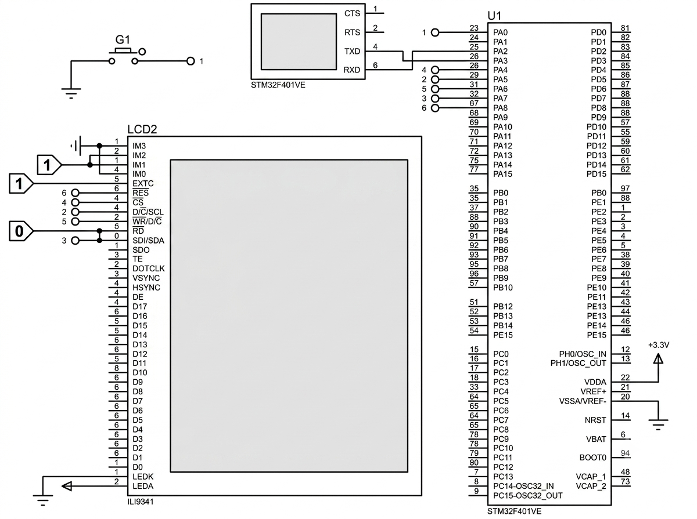

Slide 24
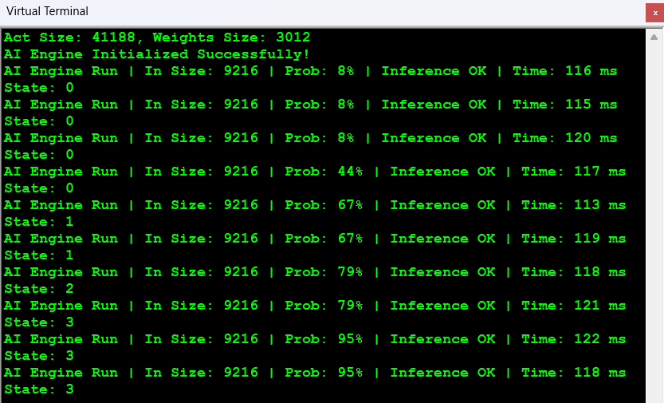
System Initialization & Boot Sequence
What happens the moment simulation starts
Model Load: Activation memory (Act Size: 41,188 bytes) and weight memory (Weights Size: 3,012 bytes) are allocated at boot.
Confirmation: The terminal prints AI Engine Initialized Successfully!, confirming the model loaded correctly into MCU memory.
Ready State: The system then enters its main loop, continuously running inference on the current simulated frame.

Slide 25
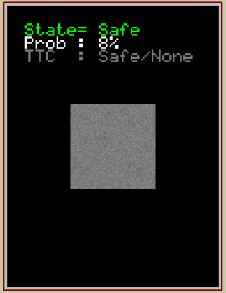
Scenario Test: Normal / Safe Condition
Baseline behavior with no obstacle present
Input: Simulated frame with background noise only, no obstacle.
AI Output: 8% obstacle probability.
System Response: FSM remains in NORMAL; LCD displays a green "Safe" status.

Slide 26
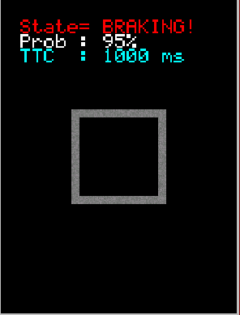
Scenario Test: Emergency Braking
Reaction to a closing obstacle
Trigger: Pressing the input button simulates an approaching obstacle.
AI Output: Obstacle probability jumps to 95%.
Risk Calculation: TTC computed at 1000 ms — below the 1200 ms braking threshold.
System Response: FSM immediately transitions to BRAKING!; LCD switches to a red warning display.

Slide 27
Performance Evaluation
Measured, not estimated, timing
Measured Inference Time: 115–122 ms per cycle, read directly from on-chip timing logged over UART.
Effective Frame Rate: Roughly 8–9 FPS at this clock configuration.
Assessment: This confirms the pipeline is functionally correct end-to-end, but the current frame rate is on the low side for a safety-critical automotive use case and would benefit from further optimization (e.g., a higher system clock or a lighter model).

Slide 28
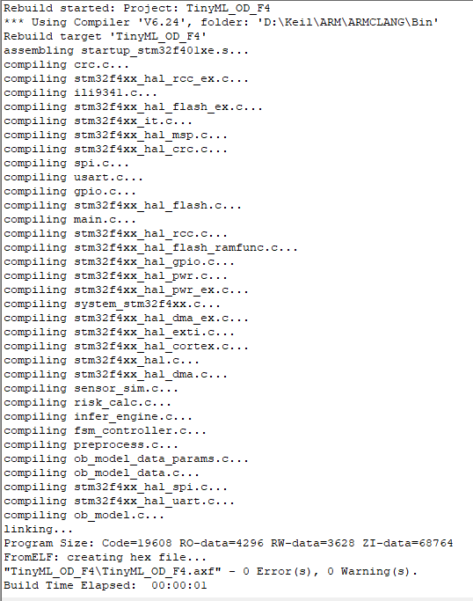
Conclusion & Toolchain Summary
From idea to a fully simulated edge-AI pipeline
Outcome: A complete obstacle-detection and emergency-braking pipeline was designed, trained, deployed, and validated entirely through simulation — no physical hardware required.
Toolchain: Python/PyTorch (model design & training) → STM32Cube.AI & STM32CubeMX (model-to-C conversion, hardware setup) → Keil MDK (firmware) → Proteus (full-system simulation).
Build Health: Final firmware compiled with 0 errors, 0 warnings.

Slide 29
Ai node: ready for integration with the master.
End of Node 5

Slide 30
We sincerely thank you for honoring this presentation with your presence and attention.
With special thanks to our esteemed professor, Dr. Zargari, for his invaluable guidance and unwavering support.
Presenting Group: Parinaz Kari| Hossein Ranjbar | Sobhan Nasiri Salar Ghasemi | Mehdi Tahouni

